Slide 1

Synthetically generate missing user preferences for Cross-network Recommendations
Dilruk Perera
(School of Computing)
Dilruk Perera, and Roger Zimmermann, “CnGAN: Generative Adversarial Networks for Cross-network user preference generation for non-overlapped users,” The Web Conference, WWW, 2019

Slide 2
Overview
Background : Cross-network Recommender Systems
Research Problem
Solution
Methodology
Experimental Results

Slide 3





Motivation: Recommender Systems
  Overwhelming amounts of information are available on today’s Web
  Information overload problem
Solution: Recommender Systems (RSs)
  Learn individual preferences from user profiles
  Automatically recommend interesting and unseen items to users
    500+ hours of videos uploaded per minute !
    270,000+ snapchat stories are created per minute !
User Profile
Recommendations

Slide 4
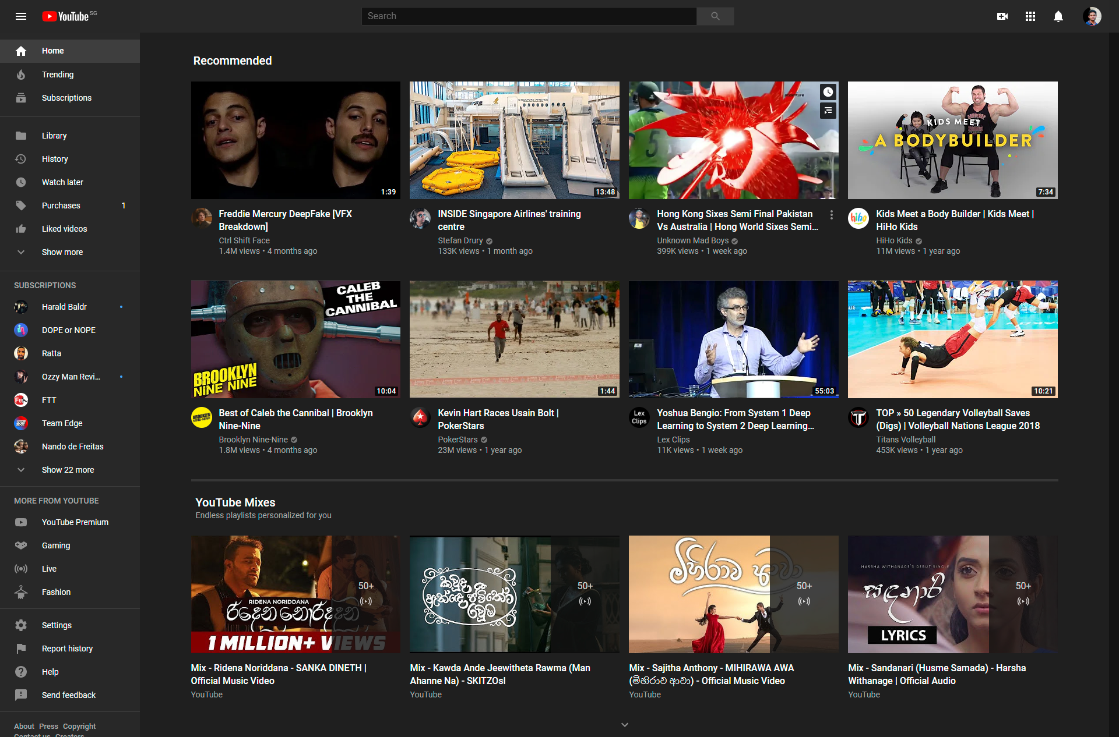
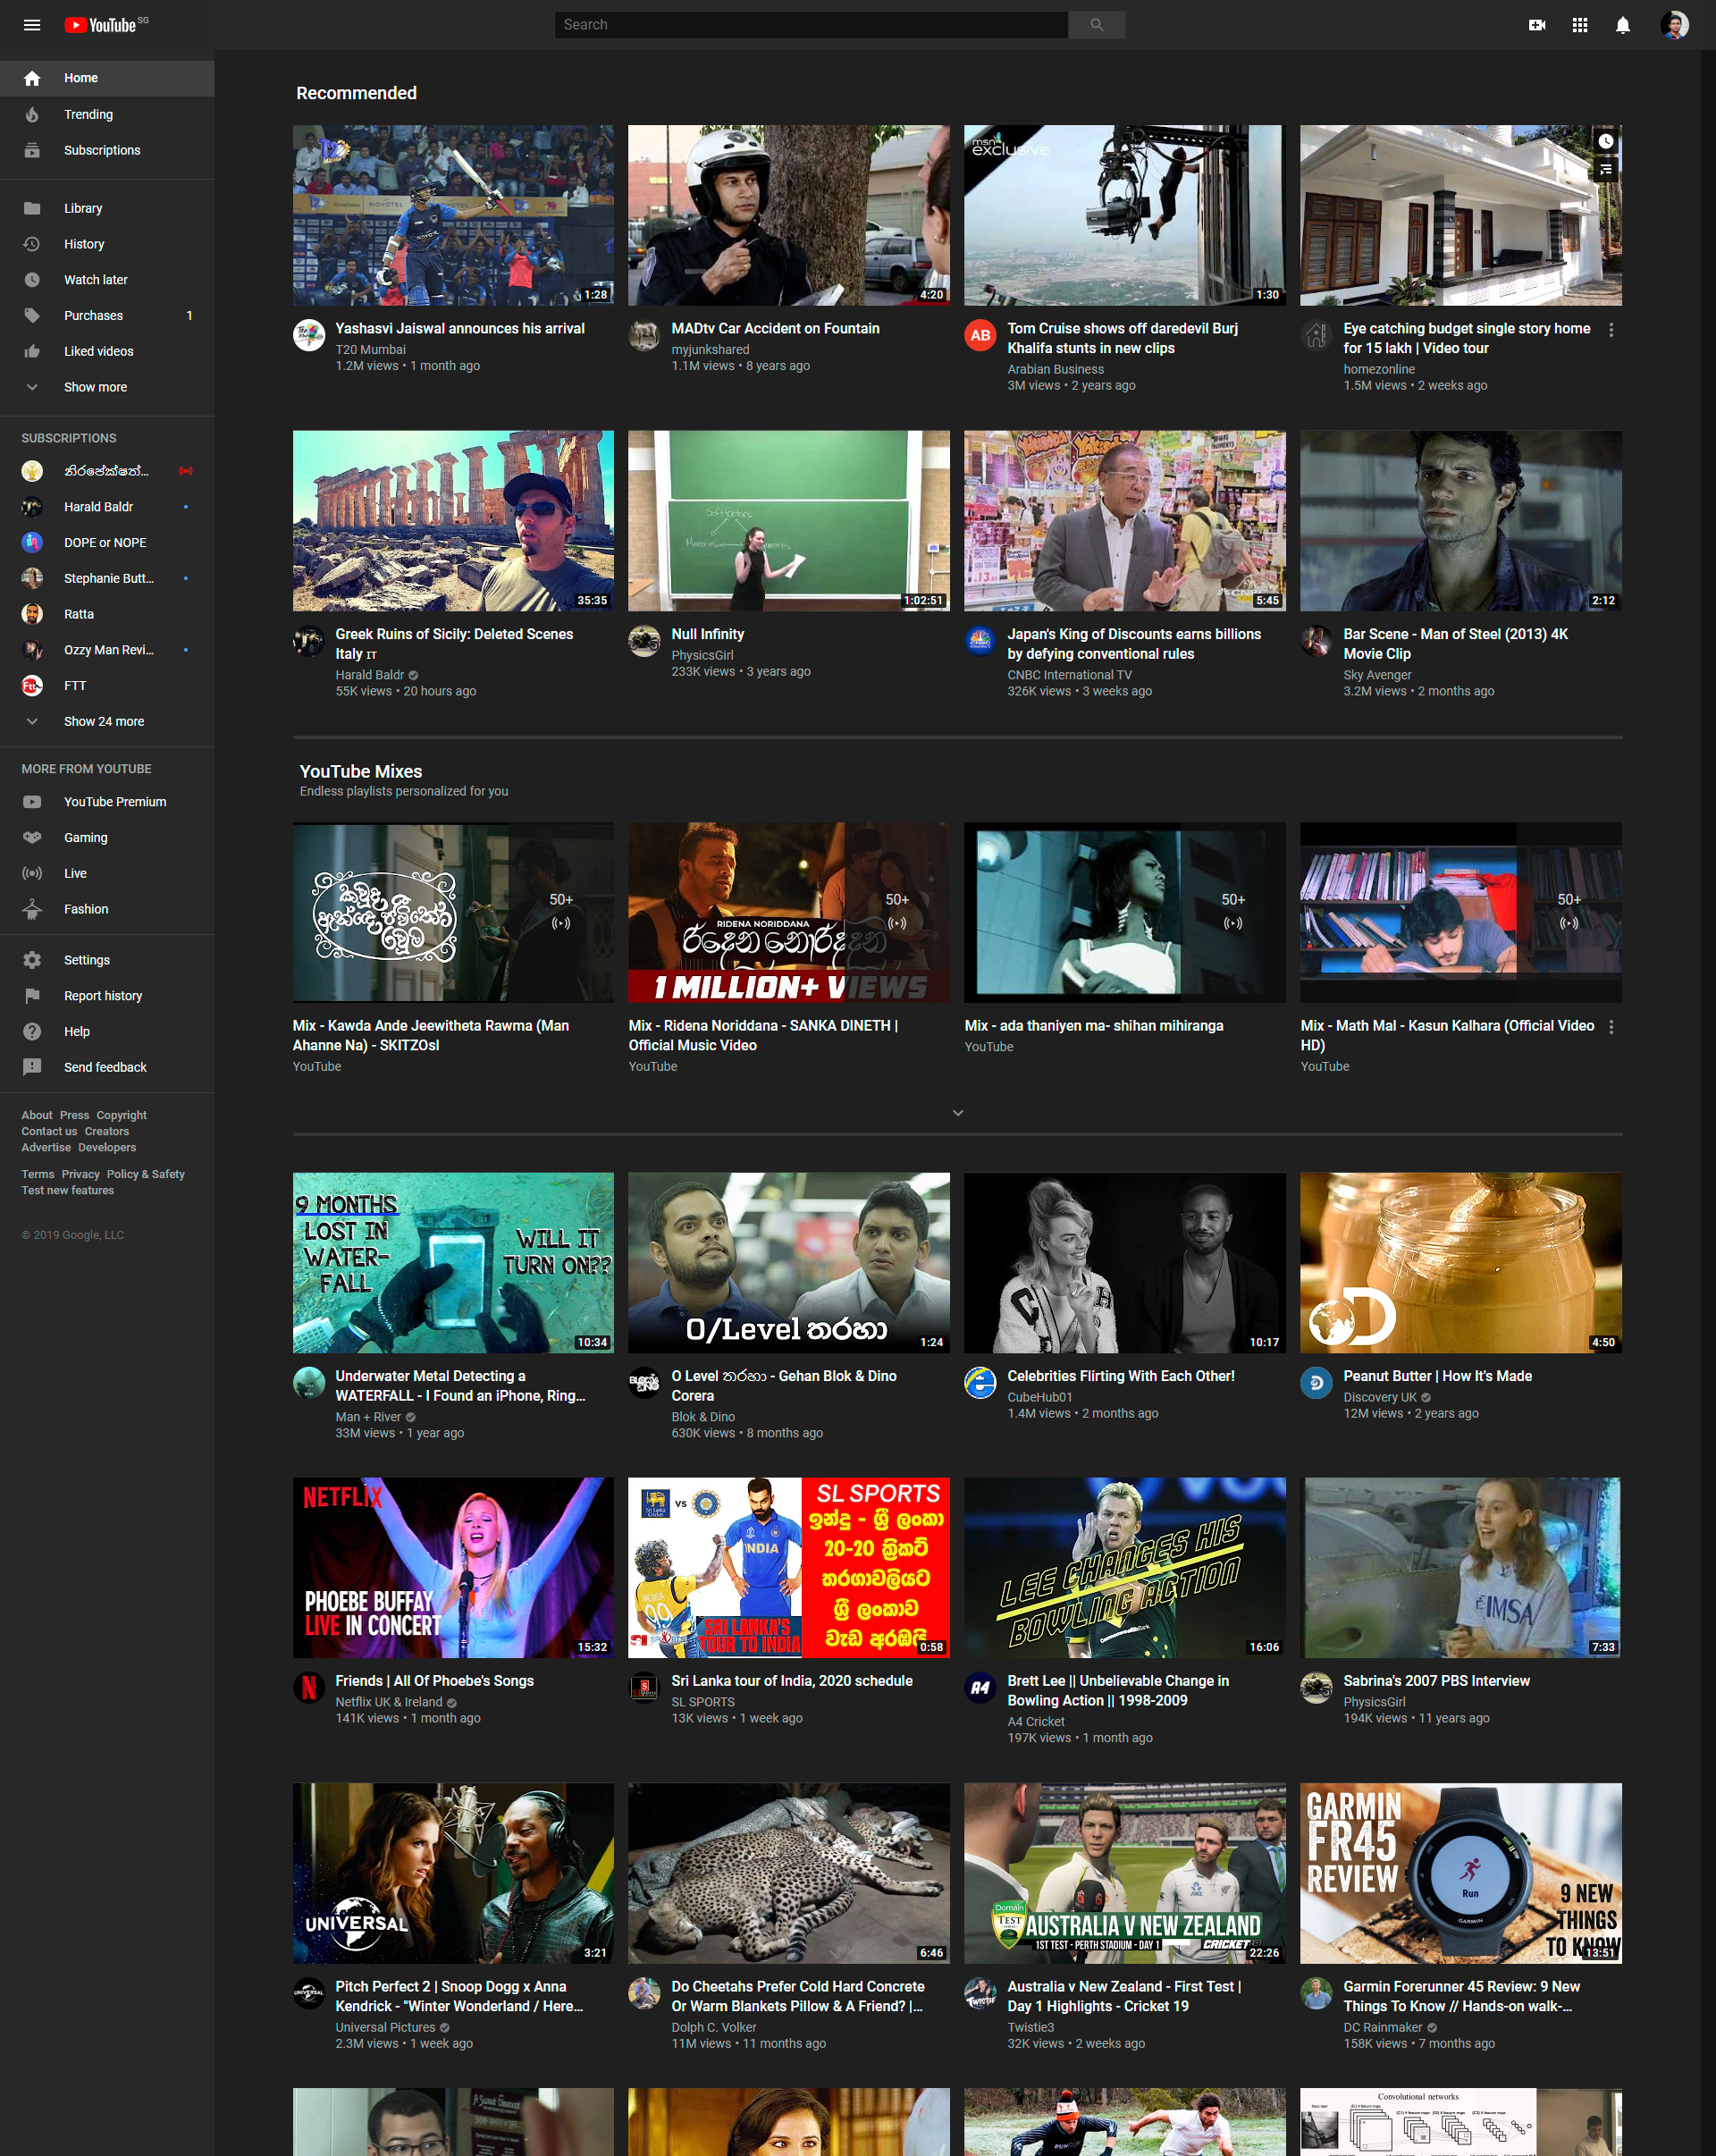


Motivation: Recommender Systems

Slide 5
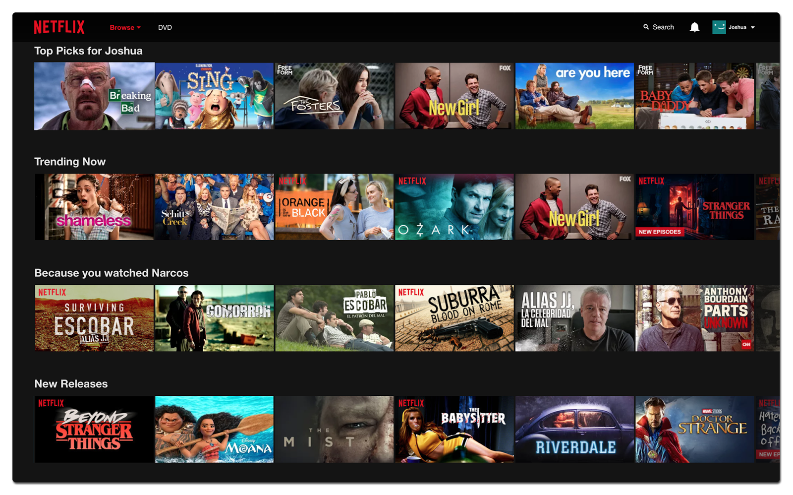

Motivation: Recommender Systems

Slide 6

Motivation: Recommender Systems
  Benefits for applications
75% of views are based on a recommendation
35% of sales are initiated by a recommendation

Slide 7




Background: Limitations of RSs
New User
  No historical interactions with items
  Cannot comprehend their preferences
  Cold Start Problem
Existing User
  High item-user ratio causes sparse interactions
  High sparsity leads to low recommender accuracy
  Data Sparsity Problem
User Profile
…
User Profile
…

Slide 8



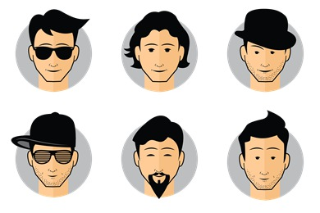
Background: Solution
Cross-network Recommender Systems
  Integrate user preference information across networks/platforms
New user (Cold-start problem)
  Transfer user preferences from other networks/platforms
Existing user (Data sparsity problem)
  Integrating rich user preference information across networks/platforms

Slide 9



Background: Cross-network RSs - Statistics
YouTube video recommendations using Twitter and Google+ auxiliary information
Source networks
Target network
Accuracy
Novelty : 11%
Diversity : 38%
Efficient to be used in practice, with minimum incremental updates
Sources: ACM MM 17, IJCAI 18, AAAI 20

Slide 10
Overview
Background: Cross-network Recommender Systems
Research Problem
Solution
Methodology
Experimental Results

Slide 11




Data Challenge
All good to replace single network recommender systems using cross-network systems?
  Existing cross-network solutions require users to be overlapped across networks
  Remaining non-overlapped users (majority) are ignored
Overlapped user
Non-overlapped user

Slide 12




Solution
Generative adversarial approach to synthetically generate missing user preferences data on source networks
Approach:
  Learn the mapping from target to source network preference manifolds using overlapped user interactions
Non-overlapped user

Slide 13




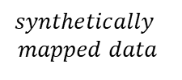
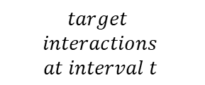




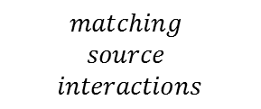




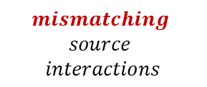
Adversarial Generation Process
$$mapping$$
$$unmapping$$
Adversarial training using 3 types of inputs:
$$Discriminator$$
$$matching$$
$data$
$$synthetically$$
$$mapped data$$
1. Matching data
$$mismatching$$
$data$
$$≪replicate≫$$
$$Generator$$
2. Synthetically mapped data
$${Enc}_{src}$$
$${Enc}_{src}$$
$${Enc}_{tgt}$$
3. Mismatching data
$$matching$$
$$source$$
$$interactions$$
$$target$$
$$interactions$$
$$at interval t$$
$$mismatching$$
$$source$$
$$interactions$$

Slide 14
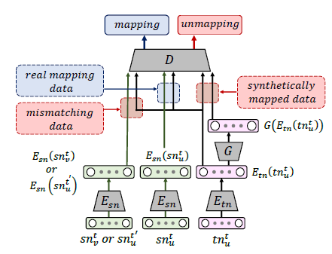
















Optimization: Generation Task
$Consists of 2 loss componenets$:
$$1. Discriminator \left(D\right) Loss:$$
$$\max_{E_{tn},{ E}_{sn}, D}{V(E_{tn},E_{sn},D)}$$
$$=L_{real}\left(E_{tn}\left({tn}_{u}\right),E_{sn}\left({sn}_{u}\right)\right)$$
$$+ L_{synthetic}\left(E_{tn}\left({tn}_{u}\right),G\left(E_{tn}\left({tn}_{u}\right)\right)\right)$$
$$+ L_{mismatch}\left(E_{tn}\left({tn}_{u}\right),E_{S}\left({\overline{sn}}_{u}\right)\right)$$
$$2. Generator \left(G\right) Loss:$$
$$\min_{G}{V(G)}$$
$$=L_{synthetic}\left(E_{tn}\left({tn}_{u}\right),G\left(E_{tn}\left({tn}_{u}\right)\right)\right)$$
$$+ L_{content}\left(E_{sn}\left({sn}_{u}\right),G\left(E_{tn}\left({tn}_{u}\right)\right)\right)$$
$$L_{real}\left(x,y\right)=\left[\log\left(D\left(x,y\right)\right)\right]$$
$$Overall Loss:$$
$$L_{synthetic}\left(x,y\right)=\left[1−\log\left(D\left(x,y\right)\right)\right]$$
$$\min_{G}{ }\max_{E_{tn},{ E}_{sn}, D}{V(E_{tn},E_{sn},G, D)}$$
$$L_{mismatch}\left(x,y\right)=\left[1−\log\left(D\left(x,y\right)\right)\right]$$
$$L_{content}\left(x,y\right)=\left\|x,y\right\|$$
$$D\left(x,y\right):Probability of Discriminator \left(D\right) identifying the given inputs \left(x,y\right) as mapping inputs$$

Slide 15




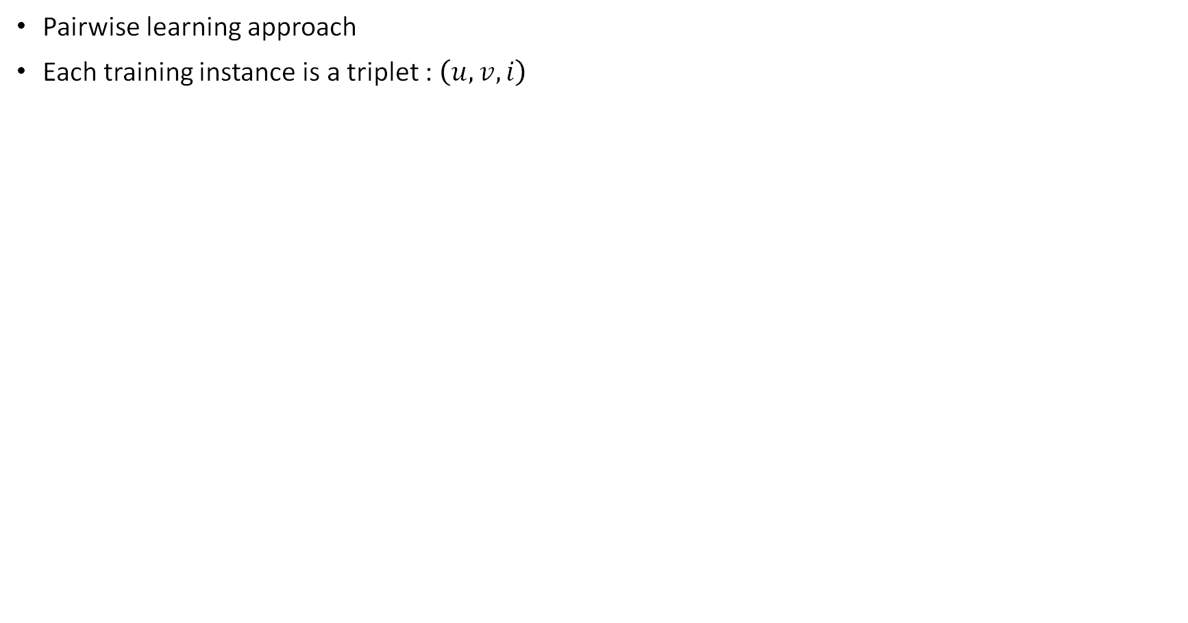







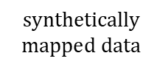




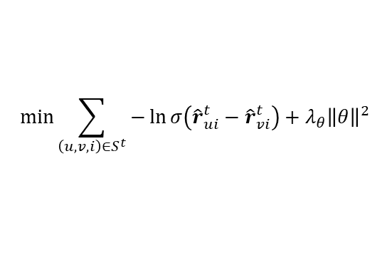



Recommendation Task
user $u$
user $v$
Pairwise learning approach
Each training instance is a triplet : $\left(u, v, i\right)$
item $i$
prediction
$${\hat{r}}_{ui}^{t}$$
$${\hat{r}}_{vi}^{t}$$
$$synthetically$$
$$mapped data$$
$$previous$$
$$interactions$$
$$user$$
$$preferences$$
Recommenda$tion \left(R\right) Loss:$
user $u$
$$\min_{ }{\sum_{\left(u, v, i\right)∈S^{t}}{−\ln{σ\left({\hat{r}}_{ui}^{t}−{\hat{r}}_{vi}^{t}\right)}+λ_{θ}{\left\|θ\right\|}^{2}}}$$
$$Neural Net$$
$${\hat{r}}_{ui}^{t}$$
$$G$$
0
…
$$item i$$
$${\hat{r}}_{ui}^{t}− {\hat{r}}_{vi}^{t}$$
1
…
0
$$maximize$$
user $v$
$${\hat{r}}_{vi}^{t}$$
$$Neural Net$$
$$G$$

Slide 16
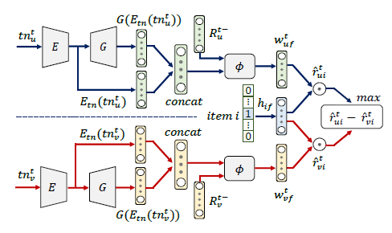

Multi-Task Learning approach
Both Generation and Recommender tasks depend on each other
  Generated user preferences are used for recommendations
  Recommendation errors are used to learn the Generator
Both tasks are learned as an end-to-end process in a multi-task learning environment
Generation
Recommendation

Slide 17
Overview
Background: Cross-network Recommender Systems
Research Problem
Solution
Methodology
Experimental Results

Slide 18
Dataset
Target network
Source network
Overlapped users | 2,372
YouTube videos | 12,782
Tweets | 2,822,112
Dataset span | 2 years (2015–2017)

Slide 19
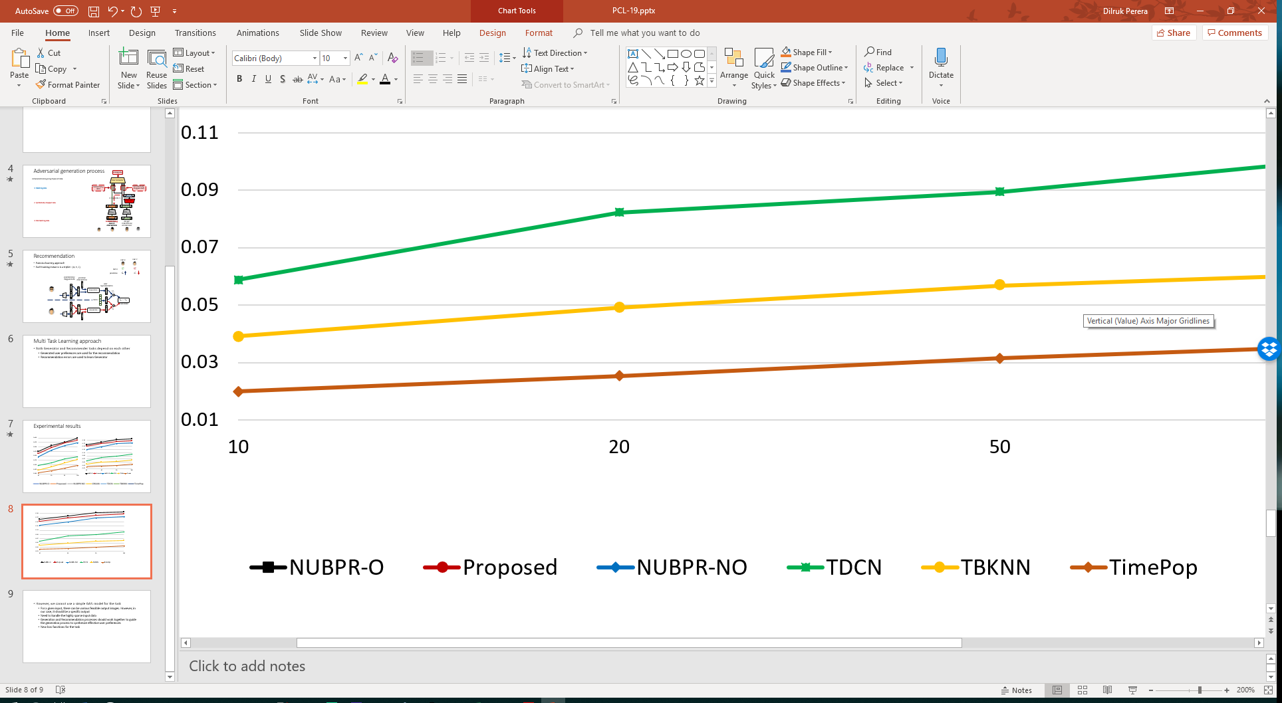
Experimental results
HR
NDCG
NUBPR-O : Fully overlapped data
Proposed : Synthetically generated data
NUBPR-NO : Target network data only

Slide 20
Main Contributions
Introduced the novel recommendation task
  Synthetically generate missing user preferences for recommendations
Proposed a novel Generative Adversarial Network (GAN) based architecture with,
  Novel loss functions for the generator task
  A user-based pairwise loss function for the recommender task

Slide 21

Thank You !
Dilruk Perera, and Roger Zimmermann, “CnGAN: Generative Adversarial Networks for Cross-network user preference generation for non-overlapped users,” The Web Conference, WWW, 2019

Slide 23
Appendices

Slide 24
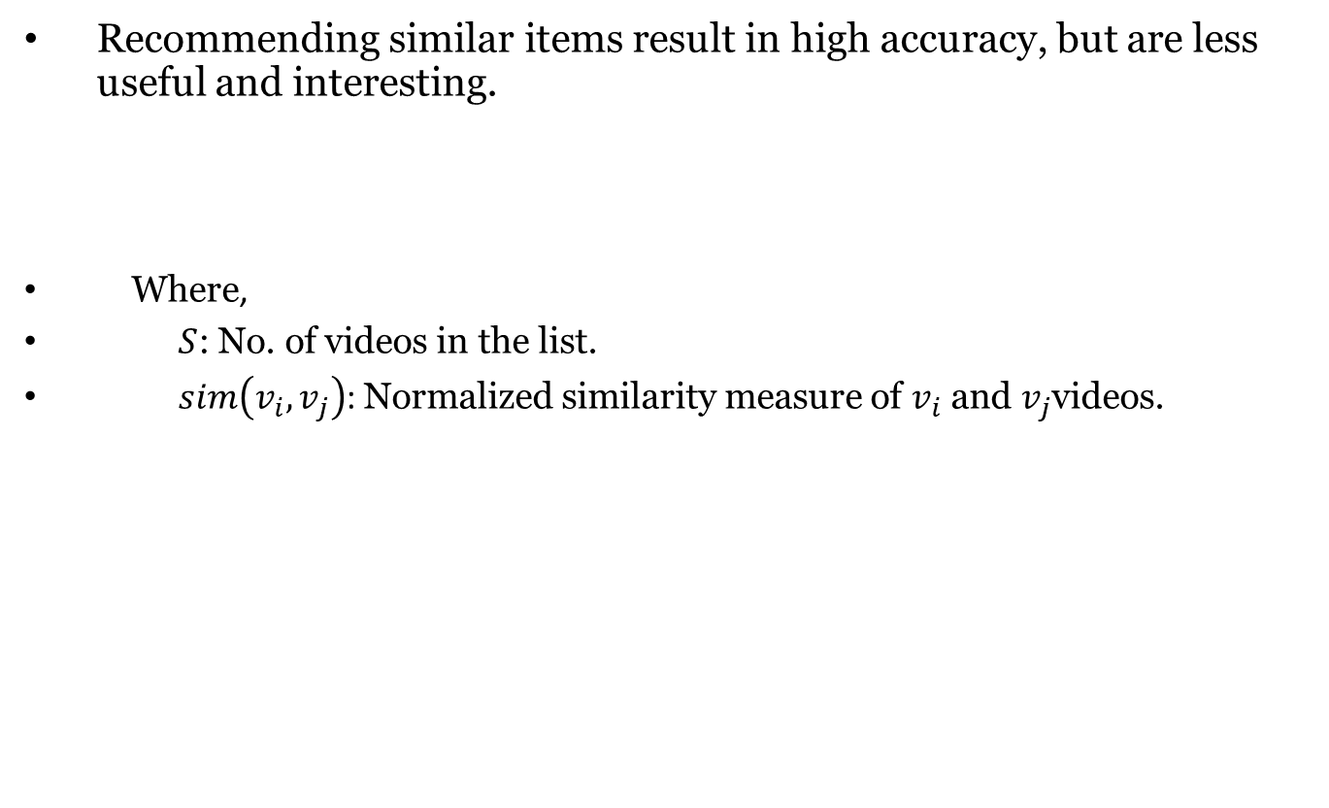
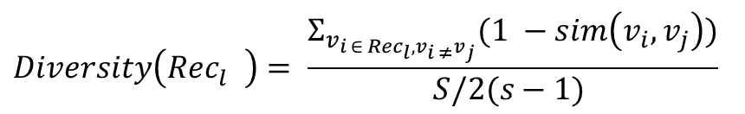
Diversity
Recommending similar items result in high accuracy, but are less useful and interesting.
Where,
      $S$: No. of videos in the list.
$sim\left(v_{i},v_{j}\right)$: Normalized similarity measure of $v_{i}$ and $v_{j}$videos.
$$Diversity\left({Rec}_{l}^{}\right)= \frac{Σ_{v_{i ∈ {Rec}_{l}, v_{i ≠}v_{j}}}(1 −sim\left(v_{i}, v_{j}\right))}{S/2(s−1) }$$

Slide 25
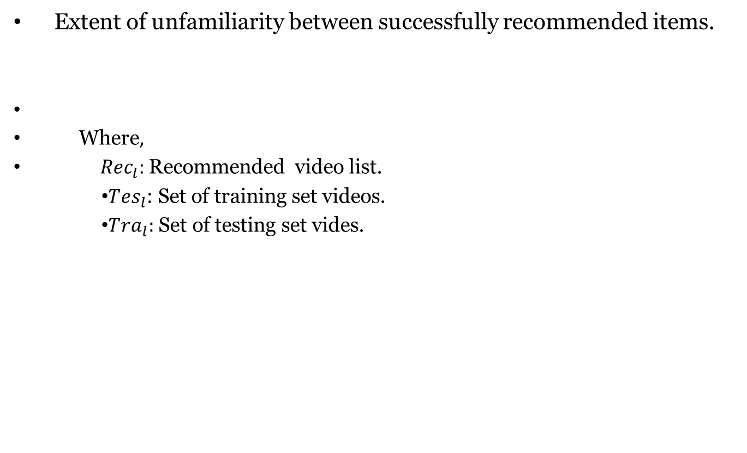
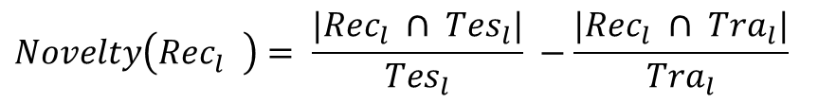
Novelty
Extent of unfamiliarity between successfully recommended items.
Where,
${Rec}_{l}$: Recommended video list.
      ${Tes}_{l}$: Set of training set videos.
      ${Tra}_{l}:$ Set of testing set vides.
$$Novelty\left({Rec}_{l}^{}\right)= \frac{|{Rec}_{l} ∩ {Tes}_{l}|}{{Tes}_{l}} −\frac{|{Rec}_{l} ∩ {Tra}_{l}|}{{Tra}_{l}}$$

Slide 26
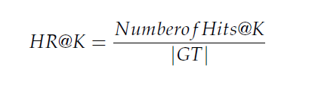
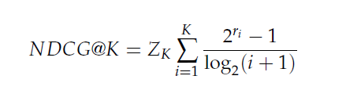
HR and NDCG
where ri = 1 if the item appears in the test set, and 0 if otherwise
Zk is the normalizer to provide that a perfect ranking has the maximum value of 1

Slide 27
3. Data Challenge

Slide 28
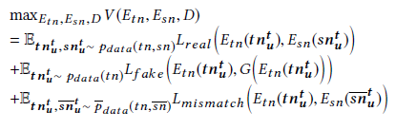





Optimization
$$\underset{D}{}$$
$$\max_{D}$$

Slide 29
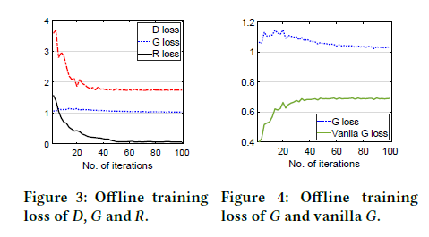

Slide 30
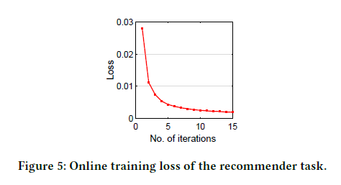

Slide 31
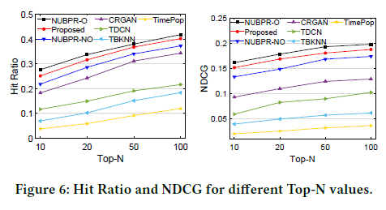

Slide 32
